Slide 1

Cloud Deployment Models

Slide 2
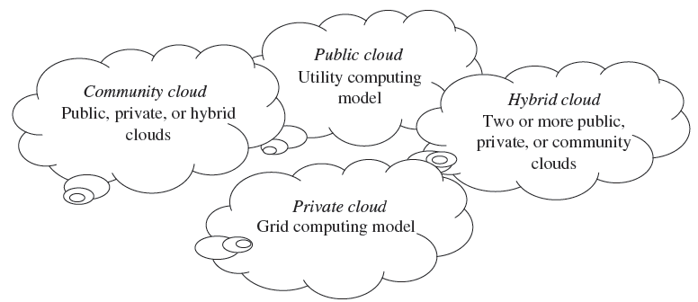
Cloud Deployment Models
Deployment models define the type of access to the cloud, i.e., how the cloud is located?
The cloud model is invented with four deployment models—public cloud, private cloud, hybrid cloud, and community cloud.)

Slide 3
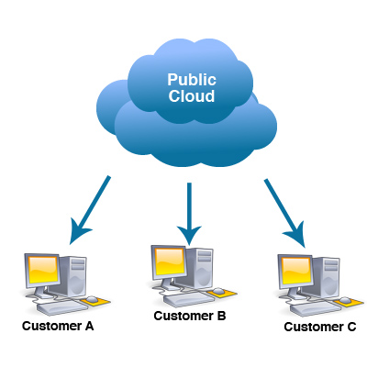
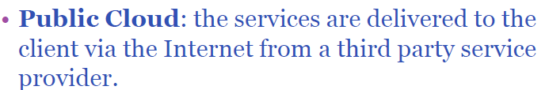
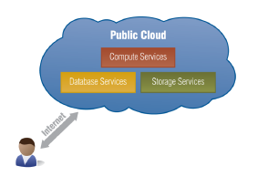
Public cloud
A Public cloud is basically the internet. Service providers use the internet to make resources, such as applications and storage, available to the general public, or on a ‘public cloud.
The public cloud is the first deployment model. In this model, users have many options to opt for and decide on any service provider as per requirement.
Some of the examples of those companies which provide public cloud facilities are: IBM, Google, Amazon, Microsoft etc. This cloud service is open for use.

Slide 4
Public Cloud
The advantages of Public cloud are:
Flexible
Reliable
High Scalable
Low cost
Place independence
Disadvantages are:
Less Secured
Poor Customizable: Not able to be modified

Slide 5
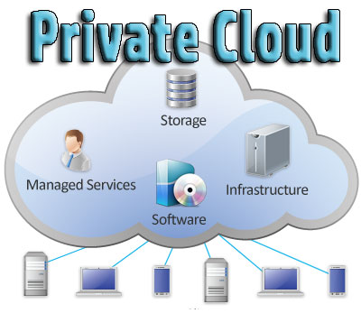
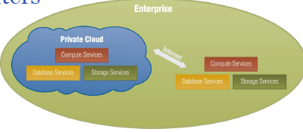
Private Cloud
Private Cloud also termed as ‘Internal Cloud‘; which allows the accessibility of systems and services within a specific boundary or organization.
The cloud platform is implemented on a cloud-based secure environment that is guarded by advanced firewalls under the surveillance of IT department that belongs to a particular organization.
Private clouds permit only authorized users, providing the organizations a greater control over data and its security.
Private Cloud are data centre architectures owned by a single company that provides flexibility, scalability, provisioning, automation and monitoring.

Slide 6
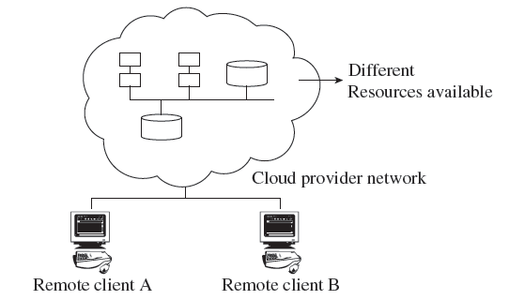
Private Clouds
The private cloud offers several advantages of an open cloud computing setting that comprises its service support and flexibility.
Private clouds allow infrastructure to be accessed only by the members of the organization and granted by third parties.
Examples of private cloud include Eucalyptus
cloud computing infrastructure with Ubuntu
Server, Elastra private-cloud, Vmware,
Microsoft, etc.

Slide 7
Private Cloud
The advantages of using private cloud are:
Highly private and secured: Private cloud resource sharing is highly secured.
Control Oriented: Private clouds provide more control over its resources than public cloud as it can be accessed within the organization’s boundary.
The Private cloud has the following disadvantages:
Poor scalability: Private type of clouds is scaled within internal limited hosted resources.
Costly: As it provides secured and more features, so it’s costlier than public cloud.
Pricing: is inflexible; i.e. purchasing a new hardware for up-gradation is more costly.
Restriction: It can be access locally within an organization and is difficult to expose globally.

Slide 8
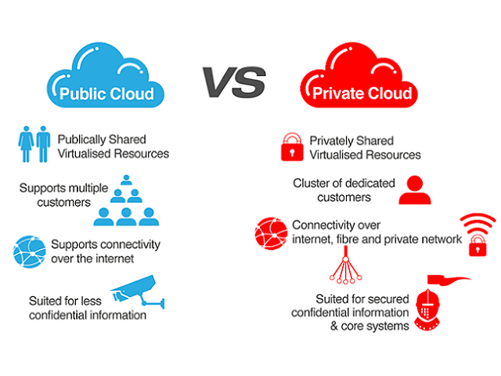

Slide 9
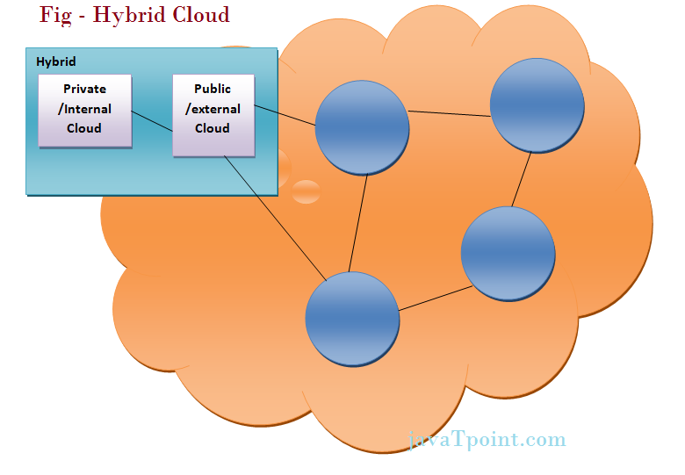
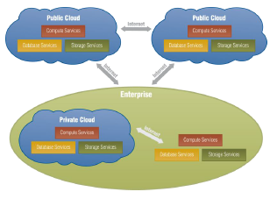
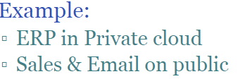
Hybrid Cloud
The Hybrid cloud is the mixture of public and private cloud. Non-critical activities are performed by public cloud while critical activities are performed by private cloud.
i.e. it can be a combination of two or more cloud servers, i.e. private, public or community combined as one architecture, but remain individual entities. Non-critical tasks such as development and test work-loads can be done using public cloud whereas critical tasks that are sensitive such as organization data handling are done using private cloud

Slide 10
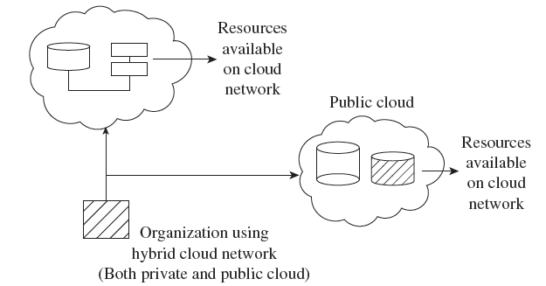
Hybrid Clouds
The hybrid cloud is a combination of a private and public cloud which is
mutually dependent on one another.
In this model, cloud users are supplied with information on the public cloud, in spite of the reality that the cloud supplier
has to maintain the company-significant
services and information in a few
instructions.

Slide 11
Hybrid Cloud
Advantages of Hybrid Cloud Computing are:
Flexible
Secure
Cost Effective
Rich Scalable
Disadvantages of Hybrid Cloud are:
Complex networking problem
Organization’s security Compliance

Slide 12
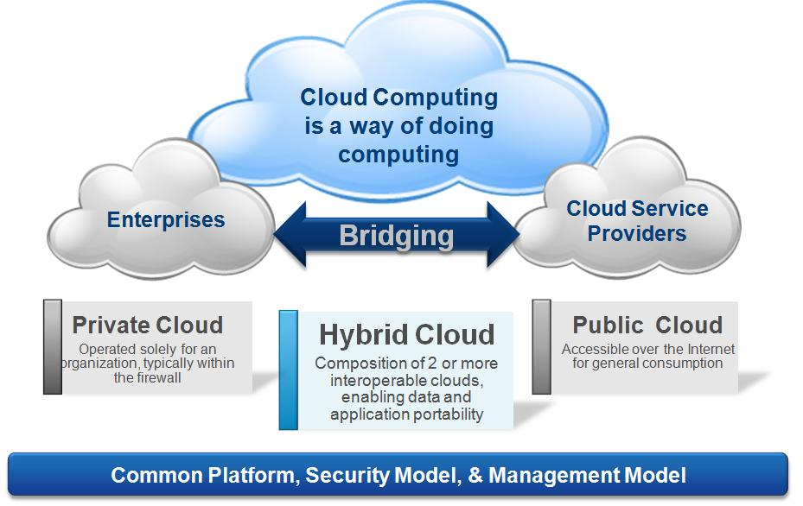

Slide 13
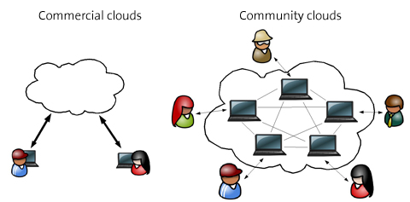
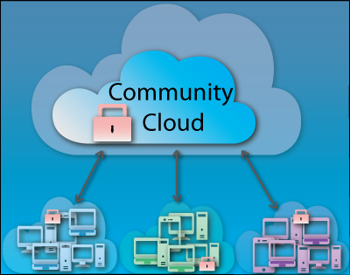
Community Cloud
Community Cloud is type of cloud computing in which setup of cloud is shared manually among different organizations that belong to the same community or area.
Example of such community is where organizations/firms are there along with the financial institutions/banks.
A multi-tenant setup developed using cloud among different organizations that belong to a particular community or group having similar computing concern.
For joint business organizations, ventures, research organizations and tenders community cloud is the appropriate solution.

Slide 14
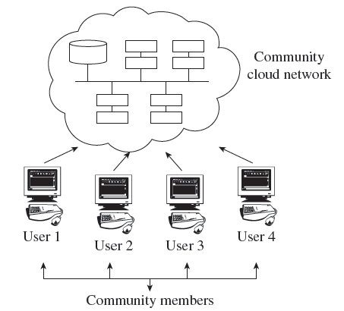
Community Clouds
A community cloud falls between public and private clouds category.
The drawback related to a community cloud is that of having costs higher than a public cloud.
Examples of community cloud include
Google’s ‘Gov Cloud’, NASA Nebula cloud,
etc.

Slide 15
Pros and cons of each architecture
IBM ICE (Innovation Centre for Education)
Benefits • Risks
Private cloud:
Fewer security concerns
IT organization retains control over data center
Private cloud:
High investment hurdle in private cloud implementation
New operational processes are required
Public cloud:
Low investment
Good test/development environment for applications
Public cloud:
Security concerns
IT organization may react negatively to loss of control over data-center function
Hybrid cloud:
Operational flexibility
Scalability
Hybrid cloud:
Hybrid clouds are still being developed
Control of security between private and public clouds

Slide 16
Deployment Models
PUBLIC CLOUD
The public cloud allows systems and services to be easily accessible to the general public. Public cloud may be less secure because of its openness.
PRIVATE CLOUD
The private cloud allows systems and services to be accessible within an organization. It is more secured because of its private nature.
COMMUNITY CLOUD
The community cloud allows systems and services to be accessible by a group of organizations.
HYBRID CLOUD
The hybrid cloud is a mixture of public and private cloud, in which the critical activities are performed using private cloud while the non-critical activities are performed using public cloud.

Slide 17
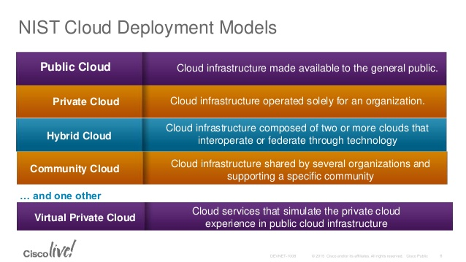

Slide 18
Alternative Deployment Models
Linthicum Model
Storage as a Service
Database as a Service
Information as a Service
Process as a Service
Application as a Service
Platform as a Service
Integration as a Service
Security as a Service
Management as a Service
Testing as a Service
Jericho Cloud Cube Model
Internal or external
Proprietary or open
Perimeterized or de-perimeterized architectures
Outsourced or insourced

